Slide 1

Job Market Analysis -Group 1-
Medhi A
Elliot F
Mike B Mike G

Slide 2

Project Overview
Purpose:
Explore and analyze the job market to find emerging trends or findings. This will create key actionable insights for individuals or firms looking to enhance their understanding of current job market trends.
Key Questions:
Are there emerging jobs/skills that are becoming increasingly important?
What are the trends of salary insights?
What is the sentiment of job descriptions?
How can we summarize these job postings quickly?
Exploration Method:
Dataset: 1.6 Million Synthetic Job Postings (Kaggle)
Toolkits:
Scikit Learn: Prediction and Modeling
SpaCy: Analysis and Summary
VADER: Sentiment Analysis
Hugging Face: Summarization

Slide 3
1
Are there emerging jobs/skills that are becoming increasingly important?
2
What are the trends of salary insights?
3
What is the sentiment of job descriptions?
4
How can we summarize these job postings quickly?

Slide 4
Exploring Skill, Jobs, and Qualifications Demands in Market
This project delves into a comprehensive analysis of skill demand trends within the job market.
Market Demand Analysis:
Most Demanding Skills:
The most in-demand skills are extracted from the dataset. This analysis provides insights into the skills sought after by employers, shedding light on emerging trends and preferences in the job market.
Most Demanding Qualifications:
The qualifications most frequently requested by employers are examined, highlighting educational backgrounds and credentials preferred in the current job landscape.
Most Demanding Jobs:
Identify the most sought-after jobs in the market. This analysis offers insights into the types of roles experiencing high demand in current market and provides context for talent acquisition strategies.
Explore Emerging Jobs:
Identify the latest in-demand roles from the past three months to guide talent acquisition and career growth.

Slide 5
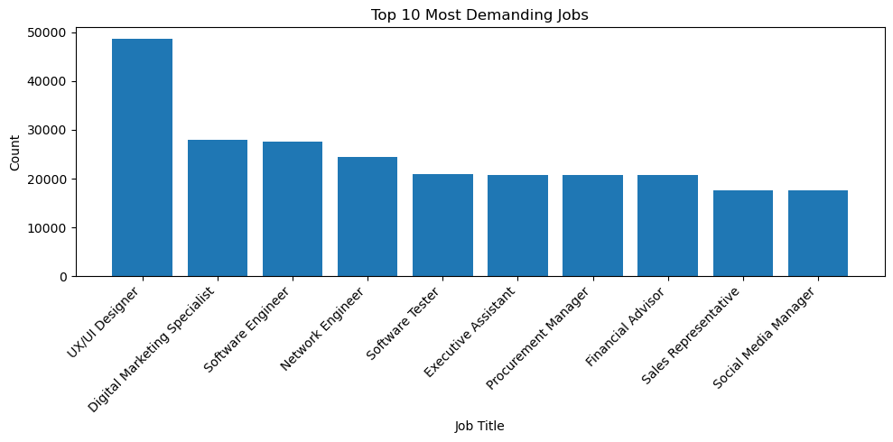
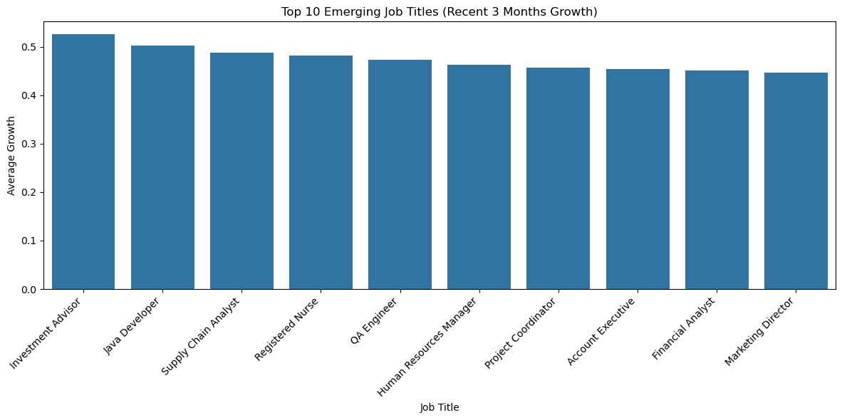
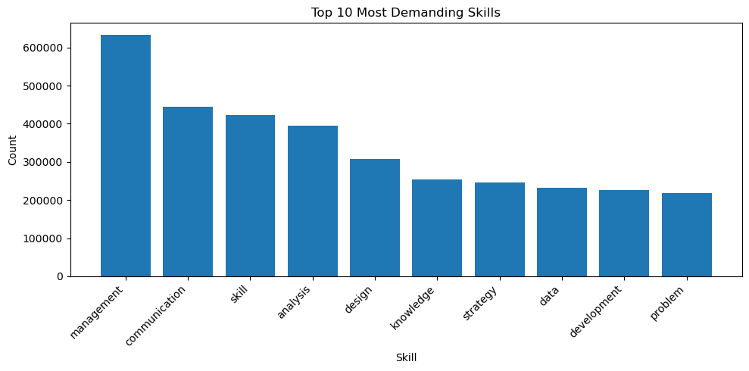
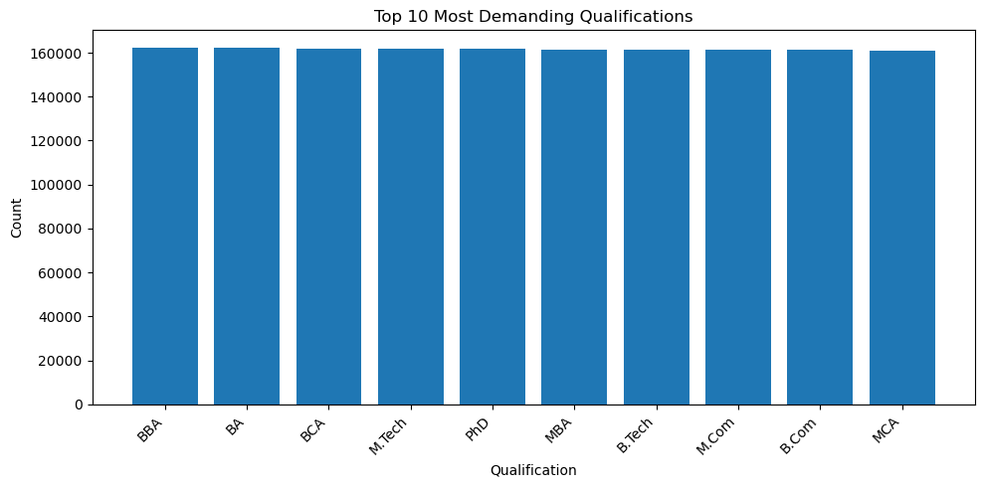
Are there emerging jobs that are becoming increasingly important?
Top 10 Emerging Jobs trending in the past 3 months
Top 10 Demanding Jobs, Skills and Qualifications
Historically, UI/UX Designers, Digital Marketing Specialists, and Software Engineers have been among the most in-demand jobs. Recently, Investment Advisors, Java Developers, and Supply Chain Analysts have emerged as the top trending roles.

Slide 6
1
Are there emerging jobs/skills that are becoming increasingly important?
2
What are the trends of salary insights?
3
What is the sentiment of job descriptions?
4
How can we summarize these job postings quickly?

Slide 7
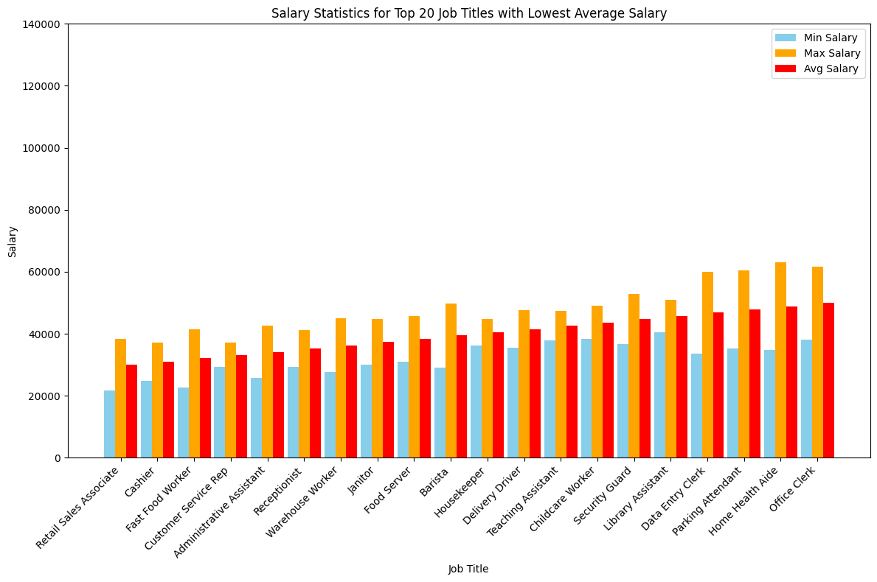
Low-Paying Job Salary Insights
All 20 lowest-paying job titles (e.g., Retail Sales Associate, Cashier) belong to the low-salary cluster.
What industries dominate the low-paying job titles?
Retail, food service, and administrative roles (e.g., Retail Sales Associate, Fast Food Worker, Office Clerk).
Why might Office Clerk have the highest average salary among low-paying jobs?
Office Clerks may require more administrative skills and work in more stable office environments.

Slide 8
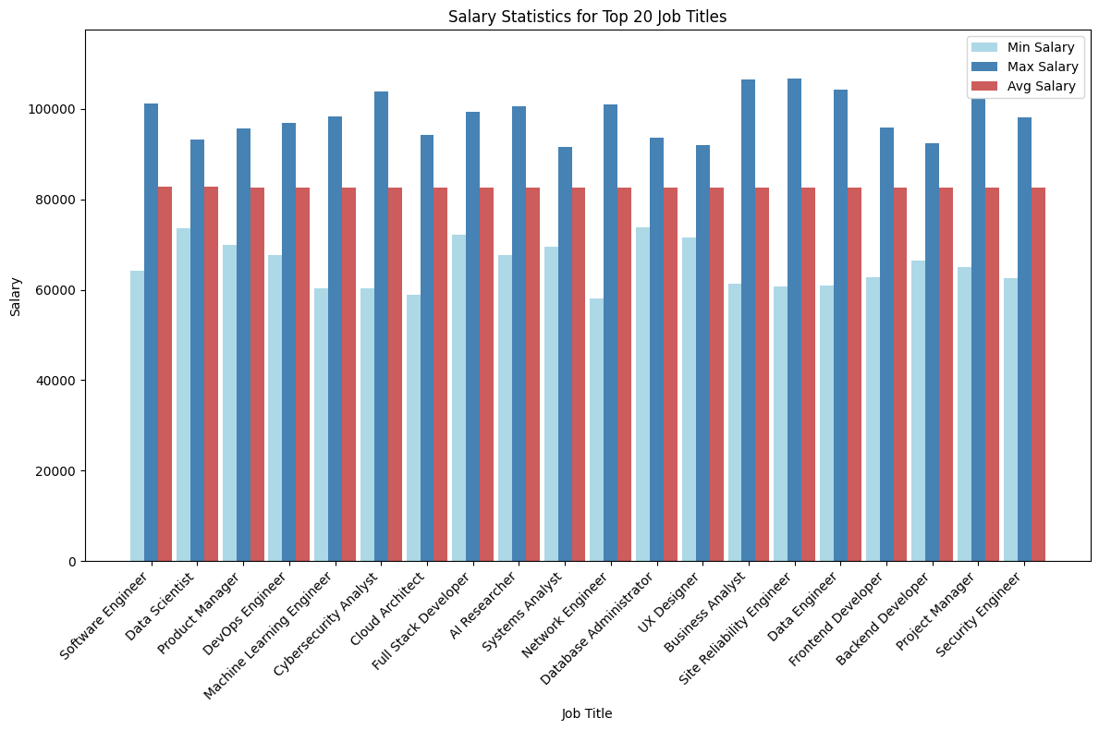
High-Paying Job Analysis
All top 20 high-paying job titles (e.g., Software Engineer, Data Scientist) belong to the high-salary cluster
Average salary range: $82,500–$82,750; Min: ~$60,000–$70,000; Max: ~$95,000–$105,000
What types of skills are common among the top-paying job titles (e.g., Software Engineer, Data Scientist).?
Answer: Technical skills in software development, data analysis, and machine learning are prevalent.
Why might Software Engineer have the highest average salary among the top 20?
Answer: High demand for software development skills and their critical role in tech industries.

Slide 9
1
Are there emerging jobs/skills that are becoming increasingly important?
2
What are the trends of salary insights?
3
What is the sentiment of job descriptions?
4
How can we summarize these job postings quickly?

Slide 10
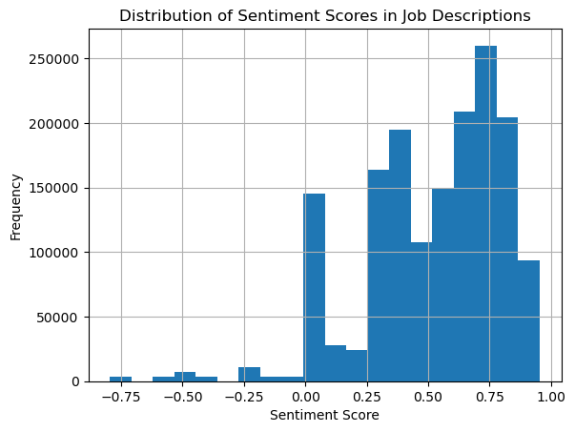
What is the sentiment of job descriptions?
Exploration using VADER (Valence Aware Dictionary and sEntiment Reasoner).
Mostly positive
VADER Analysis Results:
As you can guess, most job descriptions are positive. This is likely to paint a bright work environment to attract job seekers.
The next cluster is around the neutral area. This is likely positions that are mainly technical or legal that use factual language.
Lastly there are a few negative descriptions this could be due to a few factors
Heavy emphasis on problem solving and challenges
Warning language (performance achievement)
2. Peak around Neutral
3. Some Negative
VADER Analysis shows most job descriptions are written in a positive light.

Slide 11
1
Are there emerging jobs/skills that are becoming increasingly important?
2
What are the trends of salary insights?
3
What is the sentiment of job descriptions?
4
How can we summarize these job postings quickly?

Slide 12
AI-Driven Job Description Intelligence
This project harnesses state-of-the-art NLP techniques to extract structured insights from unstructured job descriptions What this solves
Addresses the challenge of analyzing large volumes of job postings to detect skill and role demand trends
Enables organizations and job seekers to identify high-demand technologies and roles in real time
What it does
Uses Natural Language Processing (NLP) to turn messy, unstructured job text into structured, actionable data
Leverages state-of-the-art AI models to auto-classify job roles and extract critical insights
Why it matters
Offers instant visibility into evolving workforce needs
Helps align hiring strategies, workforce development, and upskilling efforts with market demand

Slide 13
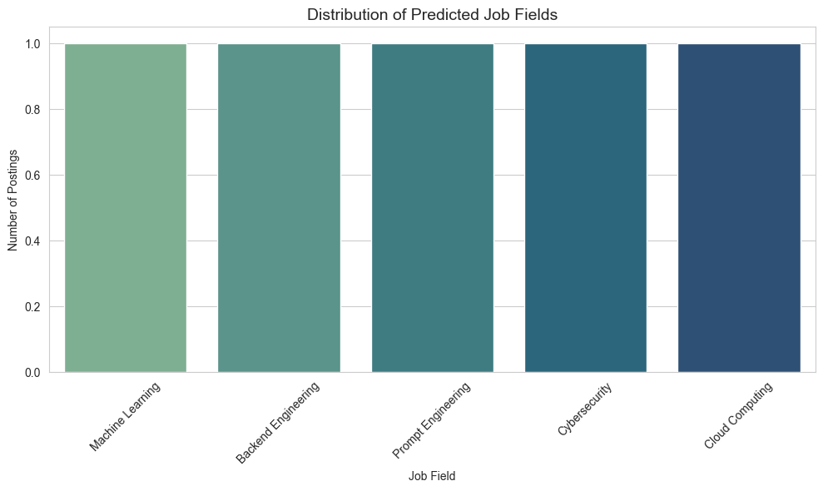
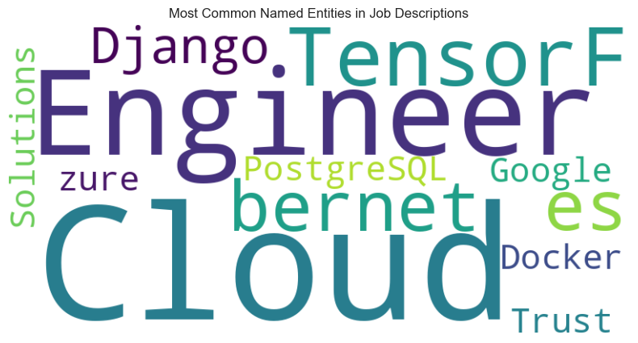
Visual Insights from the NLP Pipeline
How the pipeline works
Zero-Shot Classification: Assigns job descriptions to relevant fields (e.g., ML, Cyber, Cloud).
Summarization: Reduces lengthy descriptions to digestible overviews.
Named Entity Recognition (NER): Extracts tools, technologies, and skills.
Outcome
Clear visualizations showing top job categories and in-demand skills.
Transforms raw text into real-time intelligence for decision-making.

Slide 14

Job Market Analysis Summary
Emerging Jobs/Skills
2. Salary Trends
3. Job Sentiment
4. Digestible Descriptions
Mostly positive
2. Peak around Neutral
3. Some Negative
Key Findings
Key Findings
Key Findings
Key Findings
No1. Most demanding job: UX/UI Designer
No. 1 Skill: Management
No.1 Trending Job: Investment Advisor
No1. Max Salary: Business Analyst, Site Reliability Engineer
No. 1 Min Salary: Retail Sales Associate
Most Job descriptions are positive
Peak at neutral for technical roles
Some negative sentiments
Top descriptions include engineer, cloud, TensorF, and Bernet

Slide 15









Fin
300 Pete
THIS IS AI
Pete in the Danger Zone
Samurai Pete
LA Yuyang
Yuyang the One
Pete in Space
Pete on Everest
LOTR Yuyang
Thor Yuyang
Thank you Pete and Yuyang for teaching the course!!!

